Slide 1
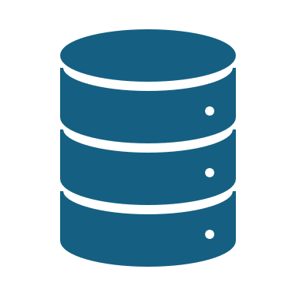
Big Data Pipeline Orchestration
A Survey from the Perspective of the DataCloud Project

Slide 2
Introduction
Presentation Focus:
Surveys Big Data pipeline orchestration tools.
Highlights insights from the DataCloud Project.
Key Areas Explored:
Objectives of the DataCloud Project.
Key components of the project.
Requirements for effective orchestration tools.
Context:
Addresses the increasing complexity of Big Data analytics.

Slide 3
Project goals and objectives
DataCloud Project Goals:
Create innovative solutions for Big Data processing.
Support processing across diverse resources (e.g., Cloud, Edge, Fog).
Lifecycle Focus:
Facilitates the entire lifecycle of data pipelines:
From design to deployment.
Key Focus Areas:
Enhance standardization, efficiency, and flexibility in Big Data architecture.
Identify innovative approaches to overcome existing orchestration challenges.

Slide 4
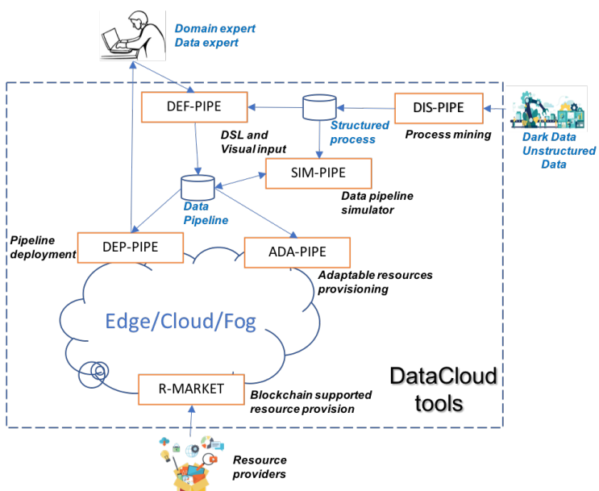
Key components and technologies
Key Components of the DataCloud Project:
DIS-PIPE:
Learns pipeline structures using process mining and AI.
DEF-PIPE:
Design reusable pipelines with visual and textual interfaces.
SIM-PIPE:
Simulates pipeline execution and predicts performance.
R-MARKET:
Manages decentralized resources using blockchain technology.
DEP-PIPE:
Enables elastic deployment of pipelines with real-time event detection.
ADA-PIPE:
Provides adaptive resource provisioning across the Computing Continuum.

Slide 5
Business case evaluations
Business Cases for Evaluation:
Smart Mobile Marketing:
Optimizes customer engagement through targeted campaigns.
Live Sports Content Annotation:
Enhances viewer experiences with real-time insights.
Digital Health Systems:
Streamlines data management to improve patient outcomes.
Purpose of Business Cases:
Serve as critical evaluation sites for orchestration solutions.
Provide insights into the practical applications and effectiveness of proposed tools.

Slide 6
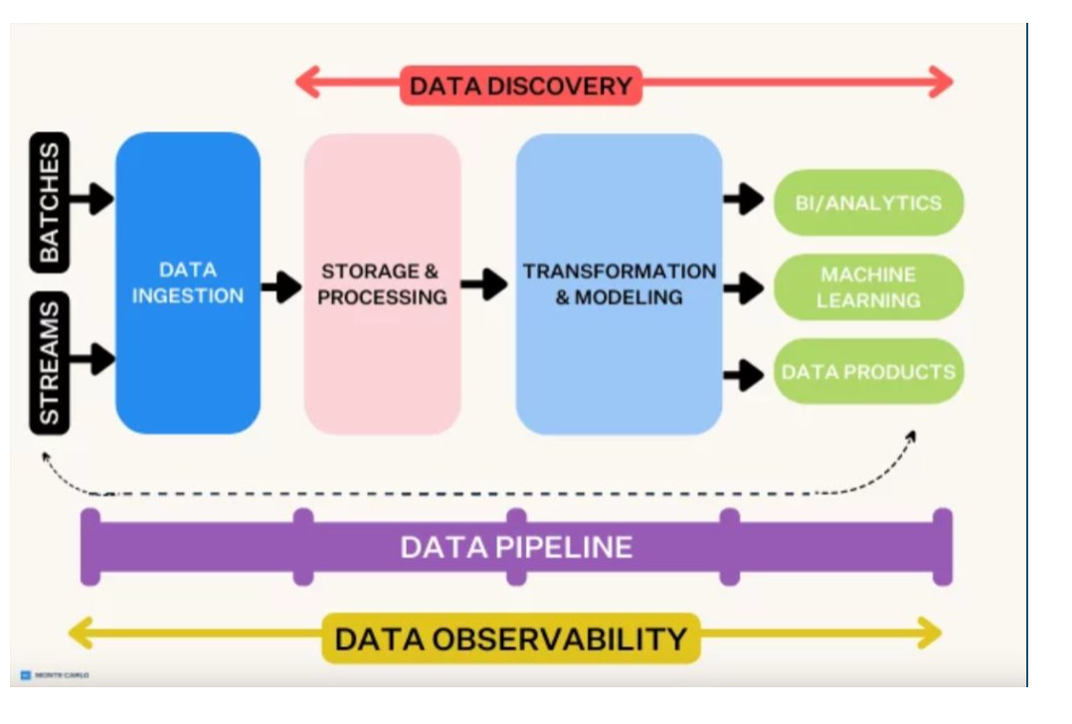
Separation of design and runtime
Key Requirement for Orchestration Tools:
Separation of Concerns:
Clear distinction between design-time and runtime activities.
Benefits of Separation:
Ensures flexibility in design, allowing it to evolve without disrupting execution.
Enables developers to:
Modify pipeline structures or components.
Adapt to changing data flows and processing needs.
Reduces:
Downtime during modifications.
Risk of errors during execution.

Slide 7
Flexibility and reusability
Key Requirements for Orchestration Tools:
Flexibility:
Adapt pipelines for various tasks.
Reusability:
Reuse existing components and workflows.
Benefits of Flexibility and Reusability:
Reduces effort required to design new pipelines.
Enables organizations to:
Leverage historical knowledge and existing solutions.
Supports interchangeable steps and modular designs.
Impact:
Leads to significant improvements in:
Efficiency.
Time management.

Slide 8
Integration with testing tools
Importance of Integration with Simulation and Testing Tools:
Validation:
Essential for validating pipeline performance before deployment.
Testing Capabilities:
Allows developers to test designs under:
Different scenarios.
Various data loads.
Early Issue Detection:
Ensures potential issues are addressed early in the design phase.
Benefits for Debugging:
Enables real-time performance evaluation and adjustments.
Contributes to the reliability and robustness of Big Data solutions.

Slide 9
Feature | Apache Airflow | Apache NiFi | Prefect | Dagster | Control-M | Argo Workflows | AWS Step Functions
Best For | Workflow automation, task scheduling | Real-time streaming, ETL | Python-based orchestration | Data pipeline testing, lineage tracking | Enterprise job scheduling | Kubernetes-native orchestration | Serverless AWS workflow automation
Workflow Model | DAG-based | Flow-based | DAG-based | DAG-based | Job-based | Kubernetes-native | State Machine
Type of Language Input | Python (DAGs) | GUI (low-code) | Python | Python | Proprietary Scripting | YAML (K8s) | JSON/YAML (AWS)
Ease of Use | Medium (Python-based, UI for monitoring) | High (Drag-and-drop UI) | High (Simple Python syntax) | Medium (Requires DAG knowledge) | Low (Complex UI, training needed) | Medium (Kubernetes-based) | High (AWS managed, low-code)
Scalability | High | High | High | High | Very High | High | High
Integrations | Hadoop, Spark, Snowflake, BigQuery | Kafka, MQTT, Elasticsearch | BigQuery, Snowflake, APIs | Limited connectors | SAP, Oracle, Mainframes | Container-based integrations | AWS Services (Lambda, S3, Glue)

Slide 10
Feature | Apache Airflow | Apache NiFi | Prefect | Dagster | Control-M | Argo Workflows | AWS Step Functions
Cloud Compatibility | Multi-cloud (AWS, GCP, Azure) | Multi-cloud | Multi-cloud | Multi-cloud | Hybrid (Cloud + On-Prem) | Kubernetes-native (AWS) | AWS-only (Tightly integrated)
Monitoring & Debugging | Strong UI, logging, DAG management | Strong real-time monitoring | Good UI, logging | Good UI, data lineage | Enterprise-grade monitoring, SLAs | Limited UI (CLI-based) | Strong UI (AWS console)
Security & Compliance | Role-based access control | SSL, Encryption | Medium (Depends on deployment) | Medium (Depends on deployment) | Very Strong (Enterprise security) | Kubernetes security controls | Very Strong (AWS IAM & security)
Encapsulation | Medium | Low | High | High | Medium | Medium | High
Cost | Free (Open-source) | Free (Open-source) | Free & Paid | Free (Open-source) | Expensive (Enterprise) | Free (Open-source) | Pay-per-use (AWS pricing)
Community & Support | Very Strong (Active open-source community) | Strong (Active, but less than Airflow) | Growing (Active) | Growing (Newer, gaining traction) | Very Strong (Enterprise support) | Strong (Kubernetes community) | Very Strong (AWS support)

Slide 11
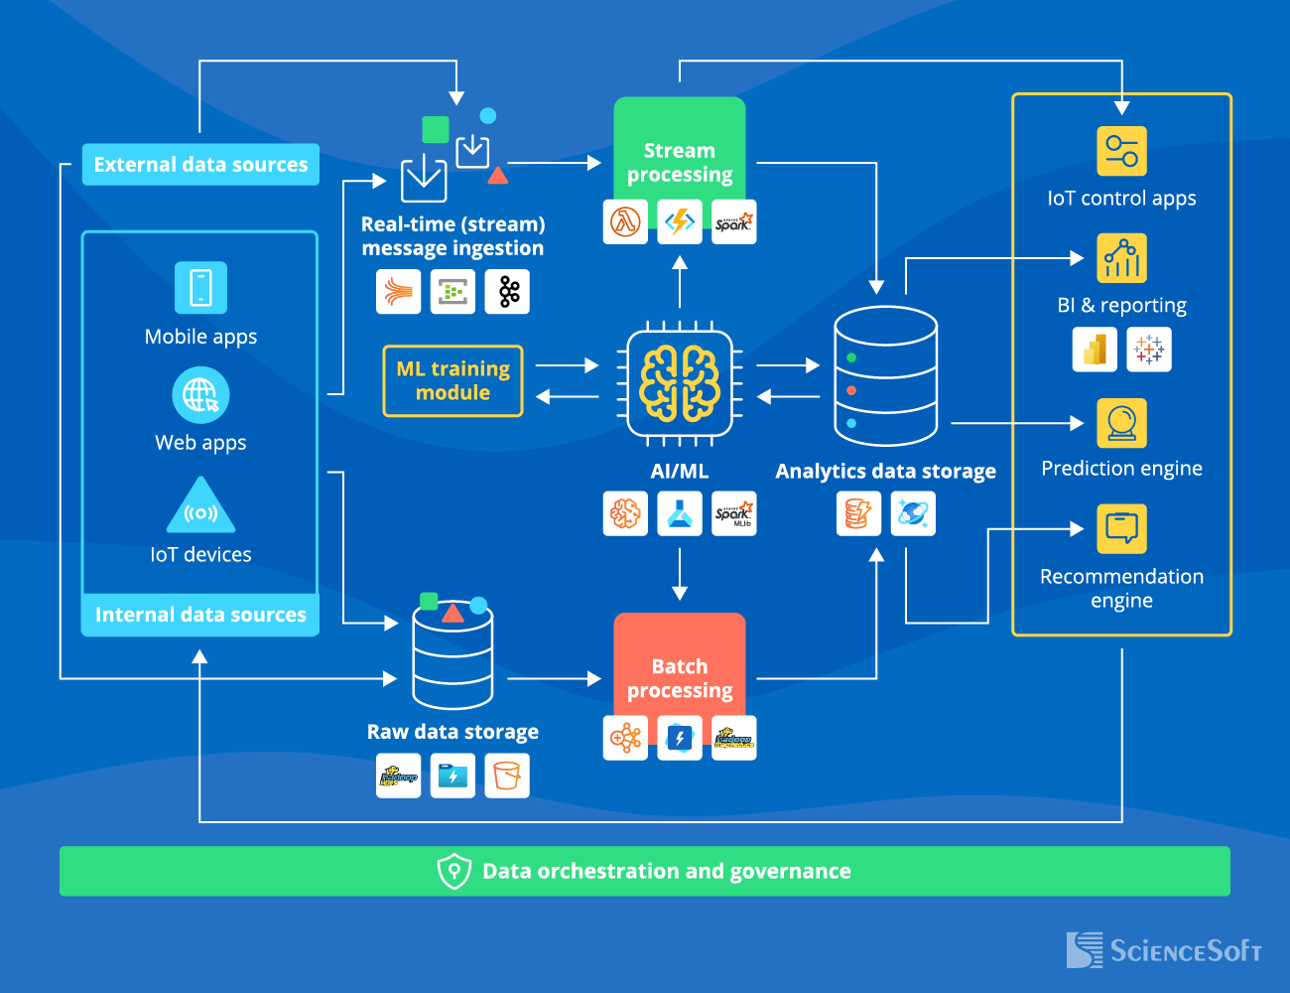
Conclusions
Key Insights from the Exploration:
Reveals critical evaluation criteria for Big Data pipeline orchestration tools.
Highlights technological advancements needed for effective data management.
Addressing Gaps and Fostering Innovation:
Identified Gaps:
Need for flexible and modular architectures.
Importance:
Enhances productivity and responsiveness in Big Data environments.
Future Developments:
Focus on implementing strategies to improve:
Design.
Deployment.
Maintenance of orchestration pipelines.

